Slide 1
Dynamic control contention window in CSMA/CA with Q-learning
Prof. Yen-Wen Chen
Student Kuo-Che Kao
2020/10/20

Slide 2
Outline
Introduction
Background and Related Work
System Model
Simulation Result
Conclusion

Slide 3
Introduction

Slide 4
Introduction
In 5G new radio(NR), massive machine type communication(mMTC) is proposed. There are about one million devices per square kilometer have communication requirements. Facing with huge connection requirements, we can use Wi-Fi to afford some task to reduce the loading on the gNB.
Under the IEEE 802.11 (Wireless LAN) standard, carrier sense multiple access with collision avoidance (CSMA/CA) is an important mechanism to reduce collision between each device.
The rule based CSMA/CA mechanism is observed that the collision happened frequently when there are huge of connection requirements. The reason is that the initial value of contention window is too small, so the device needs to retry transmission until the contention window is large enough.

Slide 5
Introduction
Reinforcement Learning is a learning process that determines behavior according to the environment. The concept of reinforcement Learning is that how a decision maker finds the behavior which can bring greatest benefit by the reward or punishment given by the environment.
In this paper, we use Q-learning to find a suitable contention window given by current environment, trying to reduce collision rate and maintain quality of throughput.

Slide 6
Background and Related Work

Slide 7
Background and Related Work

Slide 8
Background and Related Work
The backoff interval is decided by a random number which generate in [0, CW-1] multiply a time slot which we designed, so we can obtain the backoff interval as
In order to avoid insufficient contention window, the contention window size enlarge by two times while each transmitting failure, and the reset contention window size to initial value when transmitting success.
In addition, the upper bound of contention window size called max backoff stages i.e.,$CW_{max}$ can prevent the Unlimited growth of contention window size.

Slide 9
Background and Related Work
Q-learning
$Q\left(s,a\right)$ means Q-value of action $a$in current state $s$
$\max_{α}Q\left(s^{′},a′\right)$ means the maximum Q-value at next state $s′$
R means reward of perform action $a$in current state
$∝$ means learning rate
$γ$ means factor of future reward

Slide 10
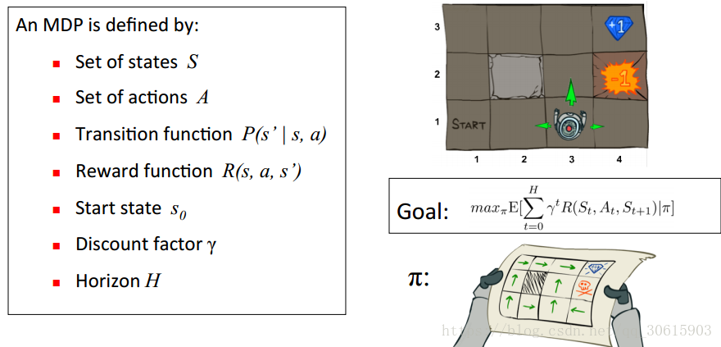
Background and Related Work
Q-learning

Slide 11
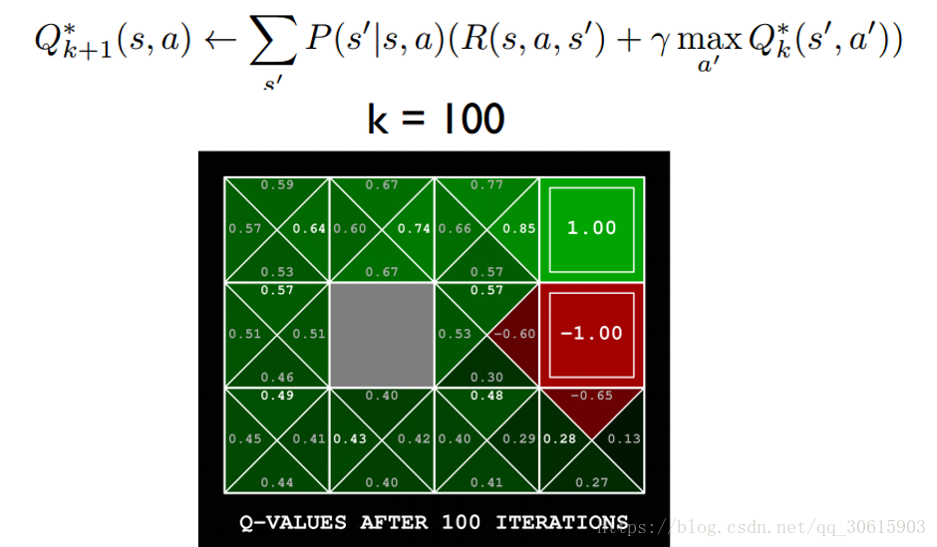
Background and Related Work
Q-learning

Slide 12
Background and Related Work
Exploration and Exploitation
The parameter $ε$ is set for exploration or exploitation which between [0, 1]. Before agent chose action$a$, it rolls a random number between [0, 1]. If the number is smaller than parameter$ε$, agent chose action $a$ with random, it is called exploration.

Slide 13
System Model

Slide 14
System Model
The system scenario considers a public space (e.g., factory, office, or class room) that contains M devices which need to use network service.
We assume that one access point (AP) can service all devices in this area, and the pass loss, SINR is very small that can be ignored, which means the channel bit rate is the same for every device.
In this paper, random access procedure is implemented by CSMA/CA, and there is no hidden node problem in this system so that RTS/CTS mechanism is not used.

Slide 15
System Model

Slide 16
System Model
In the model, we set one state, and the action is selection of contention window size. Hence, we can update the Q function as
Station will observe and record throughput for a period of time, and compare with previous throughput. If current throughput is better than previous throughput, set the reward to 1, otherwise it is -1.

Slide 17
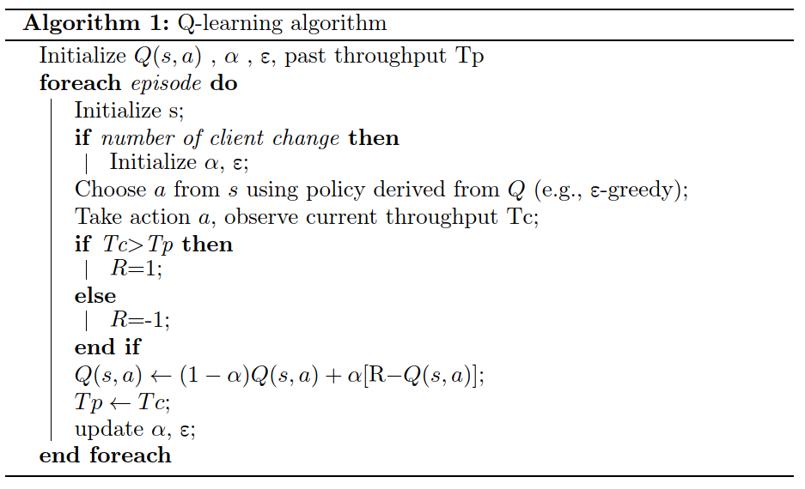
System Model

Slide 18
Simulation Result

Slide 19
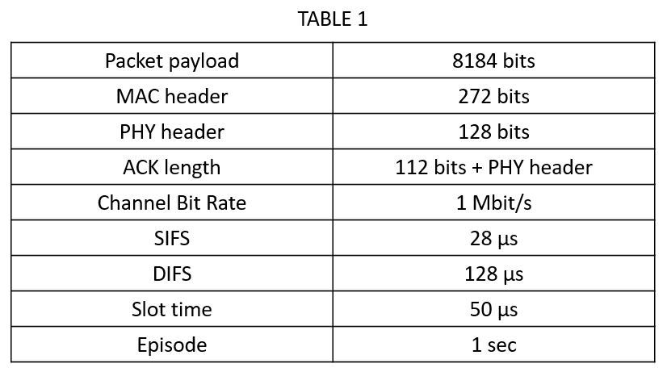
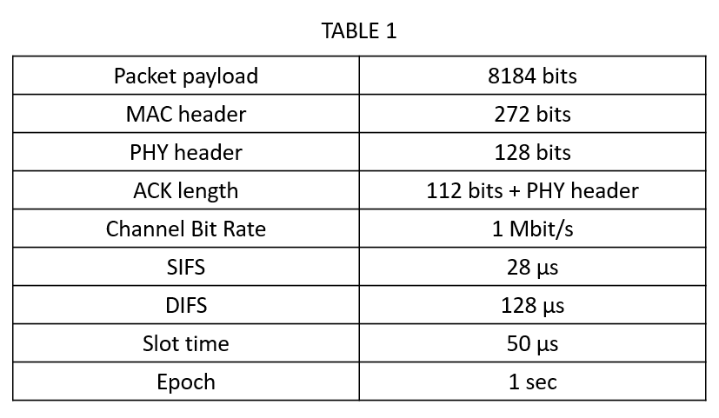
Simulation Result

Slide 20
Simulation Result

Slide 21
Simulation Result
If collision,
$$Waste time=slot time∗backoff+data+DIFS$$
$$=50∗backoff+8712 \text{µ}\text{s}$$
If successfully transmitted,
$$Waste time=slot time∗Backoff number+data+SIFS+ACK+DIFS$$
$$=50∗backoff+8980 \text{µ}\text{s}$$
$Send bits=packey payload=8184 bits$
$Throughput=\frac{success packets∗packet payload}{total waste time}$

Slide 22
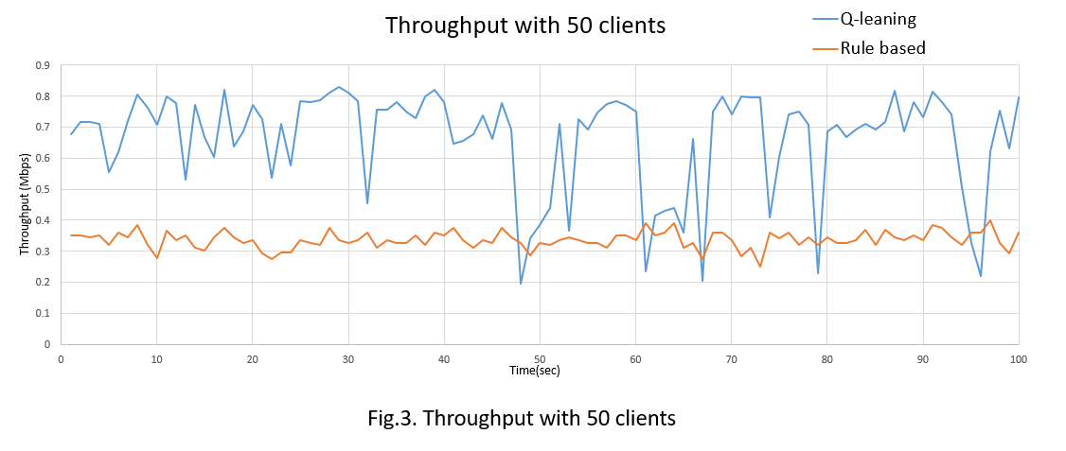
Simulation Result
In first simulation, the number of clients is fixed as 50 that express as Fig .3. In the result of picture showing, the QL has better performance than rule based after training. The point low especially in QL is affected by exploration.
It may be select an unsuitable contention window when exploration happened, but the overall performance still better than rule based mechanism.

Slide 23
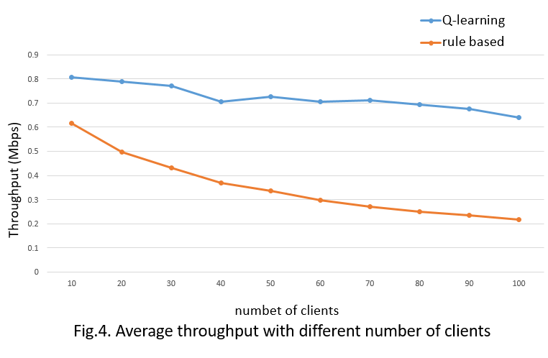
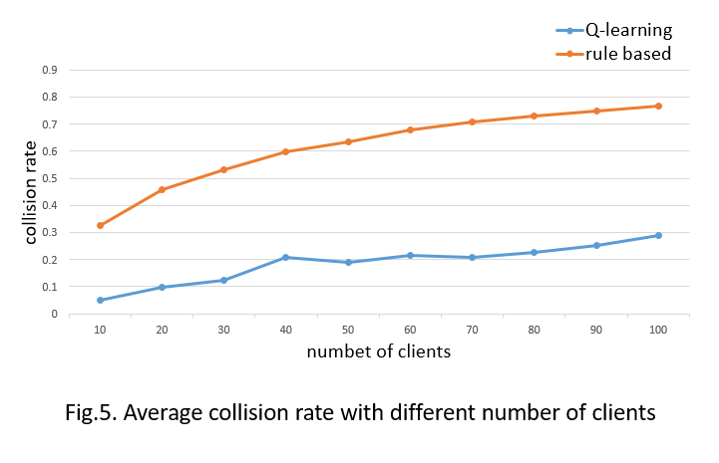
Simulation Result
On the throughput side, the QL performance is still better than rule based. For collision rate, the QL has lower collision rate and the slower upward trend.
This explains that the method of dynamic control contention can effectively reduce collisions, thereby improving network performance.

Slide 24
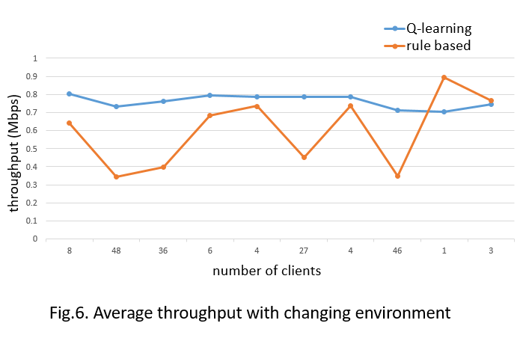
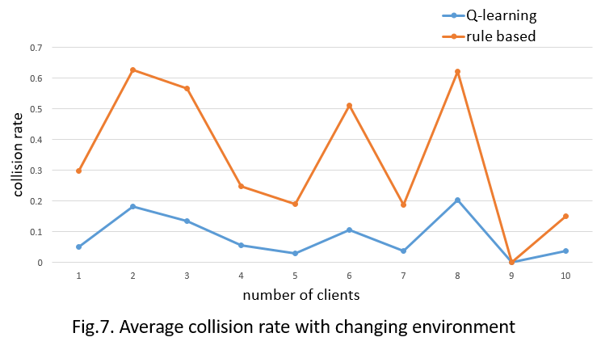
Simulation Result
The average throughput of QL is better except there are very few clients in system. The reason is that when there are very few clients in system, the contention window the rule based is designed originally for this scenario.
In long term, the QL still has better throughput and collision performance.

Slide 25
Conclusion

Slide 26
Conclusion
In this paper, we propose a method that can dynamically select the IEEE 802.11’s contention window using reinforcement learning to guarantee fairness. Simulation result show that Q-learning is a solution of random access performance. The mechanism can provide higher throughput when there are lot of connection requirements happened.
For internet of things, the connection requirements Increasing day by days. Faceing the challenge of massive IoT devices in the future, the paper proposes the mechanism which make devices connection stable and fast.

